Slide 1


SMART INDIA HACKATHON 2025
Problem Statement ID : SIH25034
Problem Statement Title : Ai Based Recommendation Engine For PM Internship Scheme
Theme : Smart Education
PS Category : Software
Team ID : CTPG11
Team Name : Pixel Pirates

Slide 2
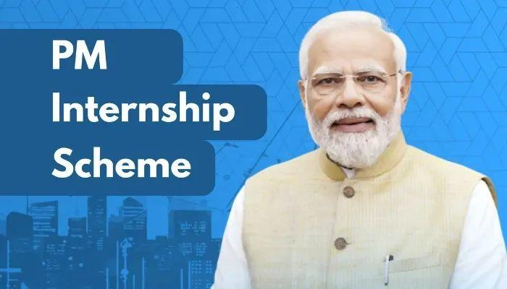



AI-Based Internship Recommendation Engine for PM Internship Scheme
Pixel pirates
PM Internship Scheme Announced in 2024 -25
Launched PILOT App on march 17
Challenges Faced by Students
Need of Our Recommendation Engine
Solution
Novelty
Proposed Solution
Collects candidate info: Education, Skills, Sector, Location
Rule-based/ML-light filtering → Top 3–5 internships
Mobile-friendly, regional language support, simple UI
Removes confusion of long internship lists
Gives personalized, relevant recommendations
Increases successful matches & reduces dropouts
PMIS-specific solution, not generic job portal
Lightweight & scalable, easy to integrate
Inclusive design: works on low-end devices, icon + language support

Slide 3



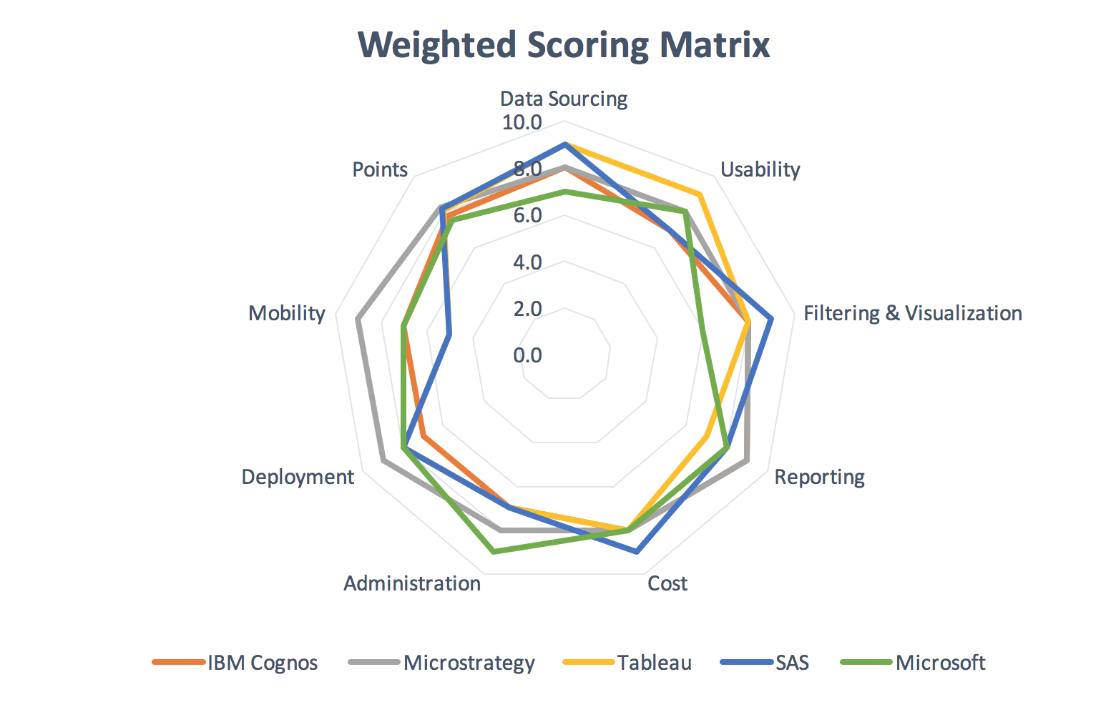

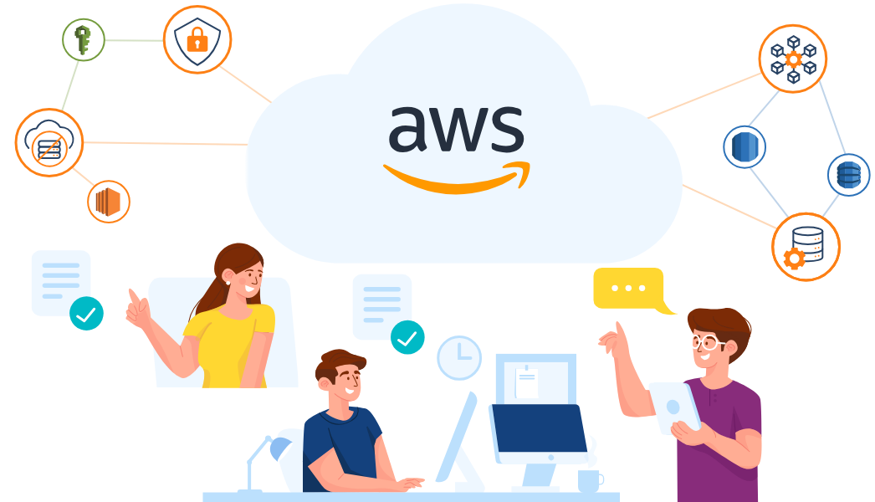
TECHNICAL APPROACH
Pixel pirates
React.js
Process
Implementation Plan
Python ( FastAPI)
Candidate gives input (education, skills, sector, location).
Backend filters internships.
Ranks internships based on match score.
Sends top 3–5 internships.
Displays as recommendation cards on UI.
Requirement Gathering.
Data Preparation.
Build Recommendation Engine.
Develop UI.
Integrate & Test.
Deploy & Get Feedback.
MySQL
Rule-based Filtering + Weighted Scoring
Google Translate API
Cloud-based (AWS)

Slide 4
FEASIBILITY AND VIABILITY
Pixel pirates
FEASIBILITY
CHALLENGES
STRATEGIES
Mobile-first approach → accessible for all users
Lightweight app → works offline in remote areas
Multilingual + voice-enabled support for inclusivity
Uses existing APIs, open datasets & low-cost Gov Cloud hosting
Data privacy & user consent
Poor connectivity in rural/remote areas
Bias in AI-based recommendations
Low digital literacy among first-gen learners
GDPR-compliant privacy & secure data storage
Offline-first design with background sync
Fairness-aware & explainable recommendation algorithms
Simple icon + voice-based UI for low literacy users

Slide 5
IMPACT AND BENEFITS
Pixel pirates
IMPACT
BENEFITS
Impact on Target Audience
Helps rural and first-generation learners find relevant internships
Encourages more participation in PMIS scheme
Social: Empowers youth, bridges urban-rural gap
Economic: Better job readiness, improved employability
Government: Higher success rate of internship matching
Scalability: Can be used across India with minimal changes

Slide 6

RESEARCH AND REFERENCES
Pixel pirates
PM Internship Scheme History
https://www.pib.gov.in/PressReleseDetailm.aspx?PRID=2112011
Recommendation System Approach https://en.wikipedia.org/wiki/Recommender_system?utm_source=chatgpt.com#Approaches

Slide 7

Pixel pirates
@SIH Idea submission- Template

